Slide 1

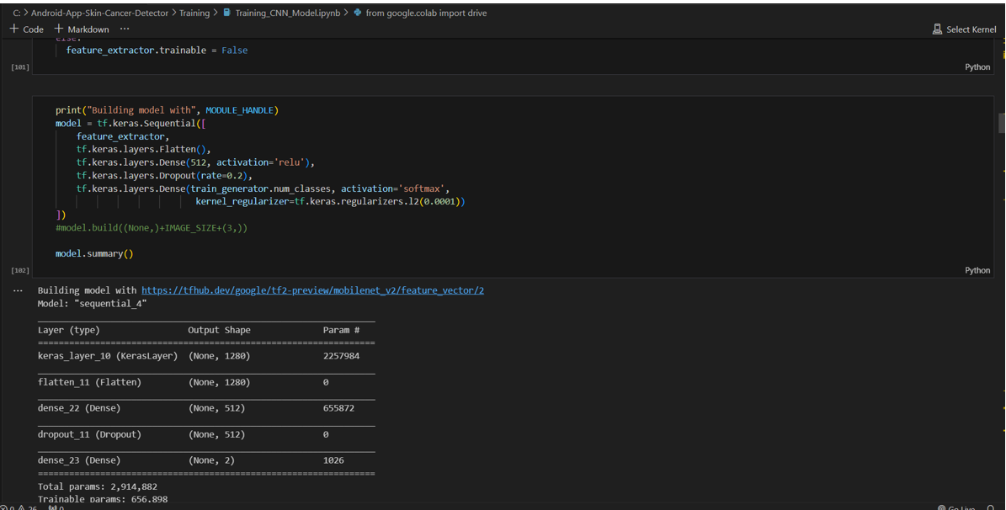
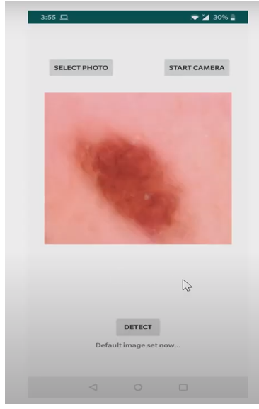
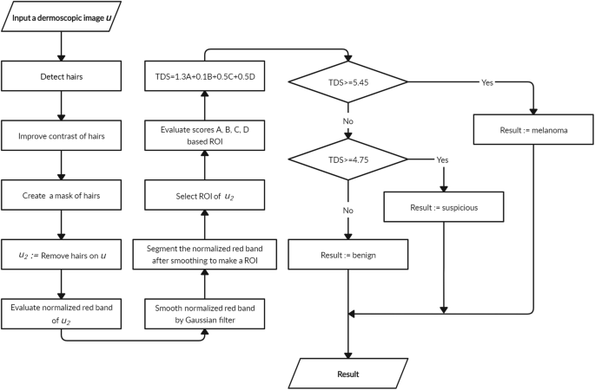
SKIN CANCER DETECTION USING MACHINE LEARNING
Department of Computer Science and Design
School of Computing
Event Name: VNR Design-A-Thon
Location: VNRVJIET ,Hyderabad , Telangana , India.
ABSTRACT
Solution
RESULTS
Technology Stack
Skin cancer is a prevalent and potentially life-threatening disease that requires early detection for effective treatment. This research aims to develop an advanced and accurate system for the early detection of skin cancer using machine learning techniques. The proposed system leverages state-of-the-art image processing and classification algorithms to analyze dermatoscopic images and accurately identify malignant lesions..
The solution for skin cancer detection using machine learning involves a systematic approach to leverage advanced technologies for early and accurate identification of malignant lesions. Initially, a diverse dataset of dermatoscopic images, encompassing both benign and malignant cases, is collected and preprocessed to standardize and enhance relevant features. Employing image segmentation techniques isolates the region of interest, enabling focused analysis. Feature extraction follows, utilizing deep learning techniques such as Convolutional Neural Networks (CNNs) to automatically discern critical characteristics. The use of deep learning models, on large datasets, further contributes to the robustness of skin cancer detection systems. These solutions often come equipped with metrics such as accuracy, precision, and recall, providing a quantitative assessment of their performance. While not a replacement for professional medical diagnosis, these machine learning solutions can serve as valuable tools, assisting healthcare professionals in prioritizing cases and improving overall diagnostic efficiency. Deploying such systems requires careful consideration of ethical and regulatory aspects, as well as collaboration with healthcare experts to ensure responsible and effective integration into clinical workflows.
Skin cancer detection using machine learning has shown promising results in recent studies. By leveraging advanced algorithms and neural network architectures, these models can achieve high accuracy in distinguishing between malignant and benign skin lesions. Metrics such as accuracy, precision, recall, and F1 score provide quantitative insights into the model's performance. Additionally, confusion matrices and ROC curves offer a comprehensive view of the true positives, true negatives, false positives, and false negatives, as well as the model's discriminatory ability.
A comprehensive technology stack for skin cancer detection using machine learning typically involves a range of tools and frameworks. Python serves as the primary programming language due to its extensive support for machine learning libraries. Libraries such as Numpy and Pandas are employed for efficient data manipulation and analysis. Scikit-learn offers a diverse set of tools for machine learning tasks, while TensorFlow or PyTorch, along with Keras, are commonly used for building and training neural networks. OpenCV plays a crucial role in image processing tasks, essential for preprocessing skin images-image provides additional algorithms specifically designed for image processing.
Figure 1.Machine Learning
Figure 2. Skin Scanning Process App.
TEAM MEMBER DETAILS
USECASES
DEPENDENCIES
Skin cancer detection using machine learning has several impactful use cases, contributing to early diagnosis and improved patient outcomes. Some key use cases include:
1. Automated Screening
2. Assistive Diagnosis for Dermatologists
3. Telemedicine and Remote Consultations
4. Population Screening Programs
[ABHISHEK KUMAR,VTU20712,7004312630]
[RAMA KRISHNA REDDY,VTU20745,9391573677]
[BANDI ANOD KUMAR REDDY,VTU20428,6302797874]
Building a machine learning model for skin cancer detection involves using various libraries and tools. The specific dependencies can vary based on the chosen programming language and framework. Here's a general list of dependencies for a Python-based machine learning project using popular libraries:
Programming Language:
Python: The primary language for most machine learning projects.
Libraries and Frameworks:
NumPy and Pandas:
NumPy: For numerical operations.
Pandas: For data manipulation and analysis.
ACKNOWLEDGEMENT
IITM KACHEEPURAM
COMPUTER SCIENCE AND DESIGN
1.Project Supervisor Name/ Designation: Dr.R.Srinivasan/Proffesor
2.Project Supervisor Contact No:9840219515
3.Project Supervisor Mail ID:
Srinivasan@veltech.edu.in
Flow Chart 1 :Detecting the target

